Slide 1
Global Terrorism
Analysis
By: Neil Liberman

Slide 2
Introduction to the Data
A list of every terrorist attack from 1970-2015
Date, Country, Region, Type of Attack, Target(s), etc.
Missing all entries for 1993

Slide 3
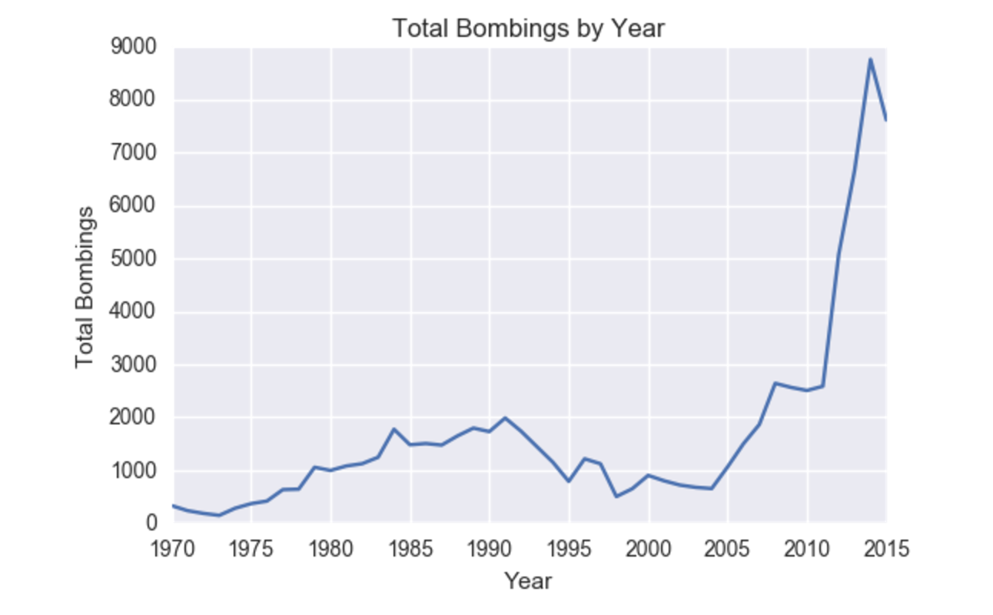

Slide 4
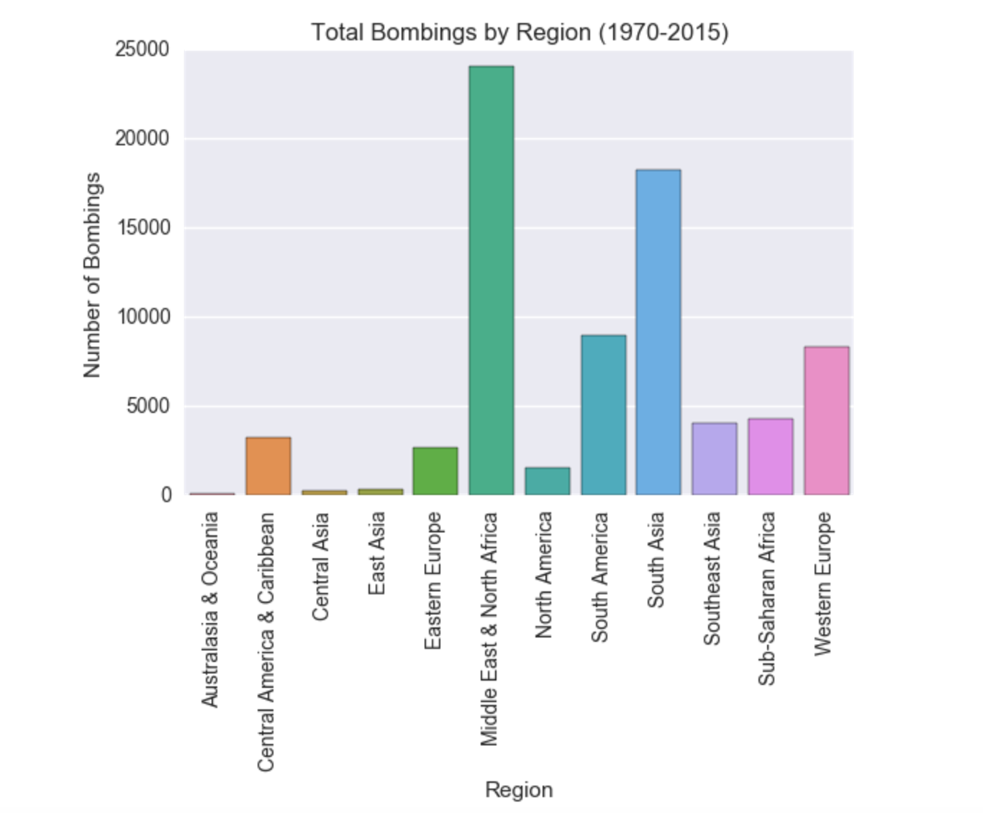

Slide 5
Bayesian Inference
Analyzing South American terrorist attacks.
After seeing the mean number of terrorist attacks in South America, I chose to analyze the bombings in South America 10 years before and after Pablo Escobar’s death.

Slide 6
Constructing a Prior
Prior beliefs were rooted in the breakdown of terrorist attacks by region.
Prior: Average Bombings per Year in South America from 1970-2015
Mean: 198, SD: 239
Chose this prior due to my complete uncertainty about whether South America’s distribution changed.

Slide 7
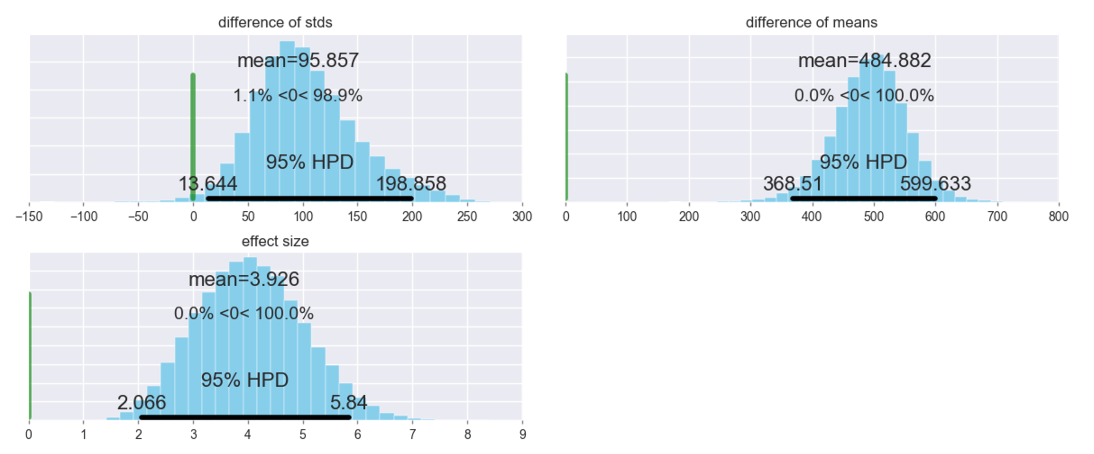
PyMC Output
The 95% HPD does not overlap with zero. In other words, when we subtract the means of the two groups, that difference isn’t close to zero.

Slide 8
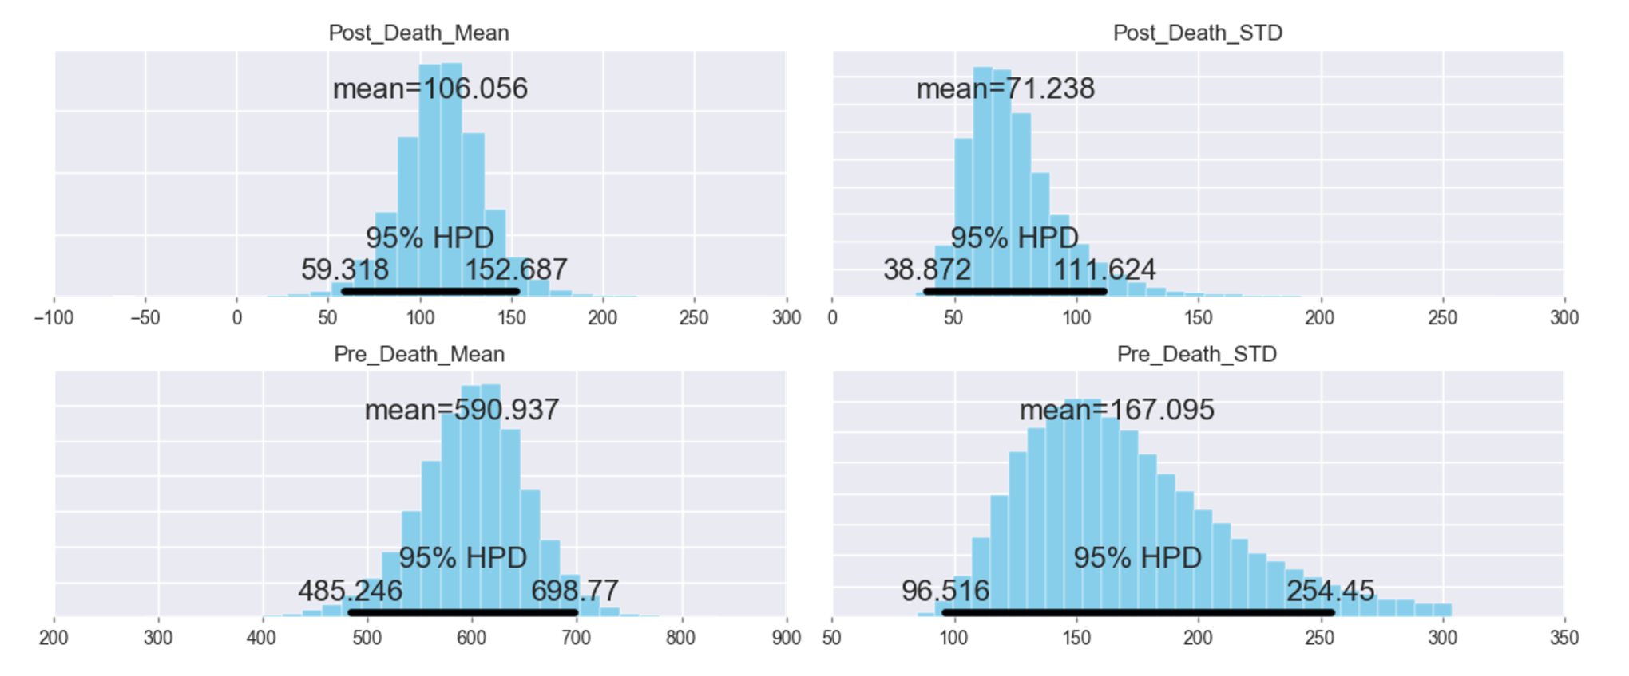
Terrorist Bombings Per Year Pre Escobar’s Death: 591
Terrorist Bombings Per Year Post Escobar’s Death: 106

Slide 9
What Do These Graphs Say?
The samples are statistically significantly different!
Intuitively this makes sense
There’s a 95% probability the mean bombings from 1983-1992 is between 485-699
There’s a 95% probability the mean bombings from 1994-2003 is between 59-153

Slide 10
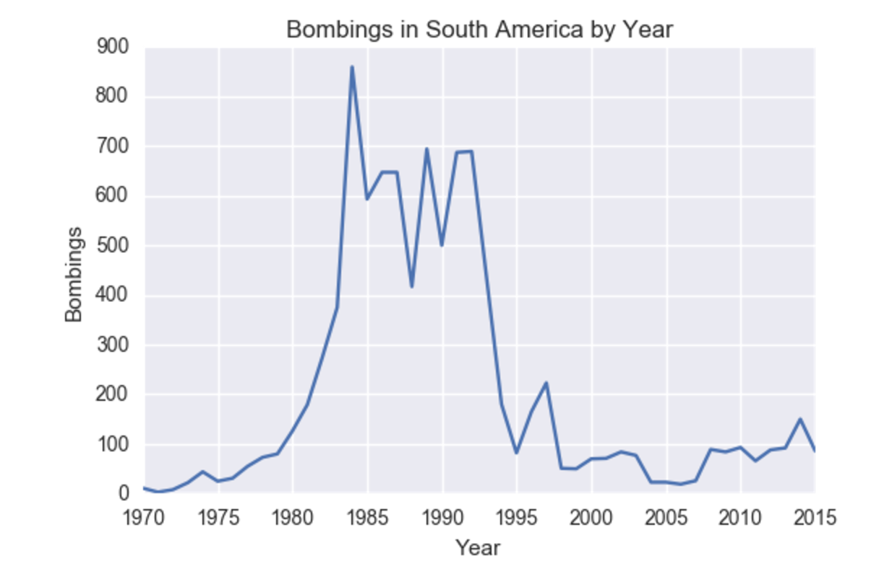

Slide 11
Did Escobar’s Death Cause this Drop in attacks?
It would be inaccurate to say Escobar’s death caused this drop, however, the massive drop in South American attacks would signal the possibility that it was a large contributing factor.

Slide 12
Imputing Bombings for 1993
Methodology:
Group the data by region and average the total bombings from 1990 - 1996 by each region. Sum the regional averages.
Total Calculated Bombings: 1431
Use the percentage of terrorist attacks that were bombings from 1990-1996. Multiply by the total number of incidents according to the GTD appendix.
Total Calculated Bombings: 1837

Slide 13
Aggregating the Two Methods
Performed a simple average:
(1431 + 1837) / 2
Final Estimated Bombings Per Year: 1634

Slide 14
Questions?

